Slide 1
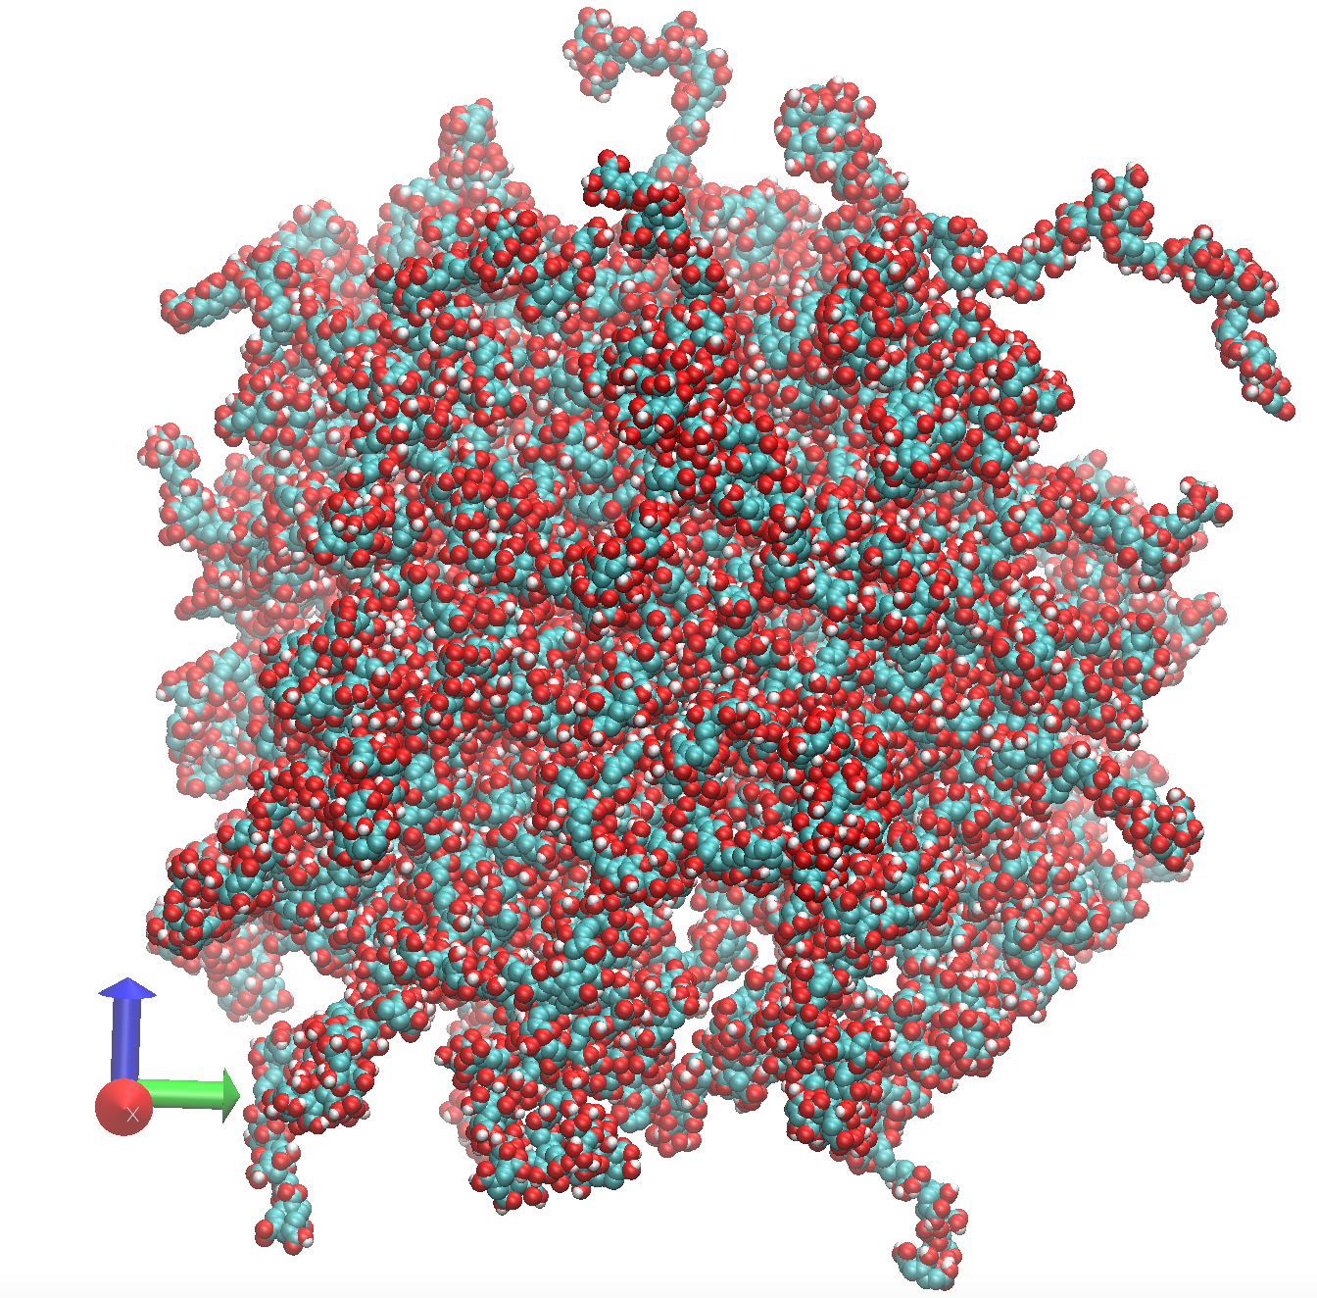
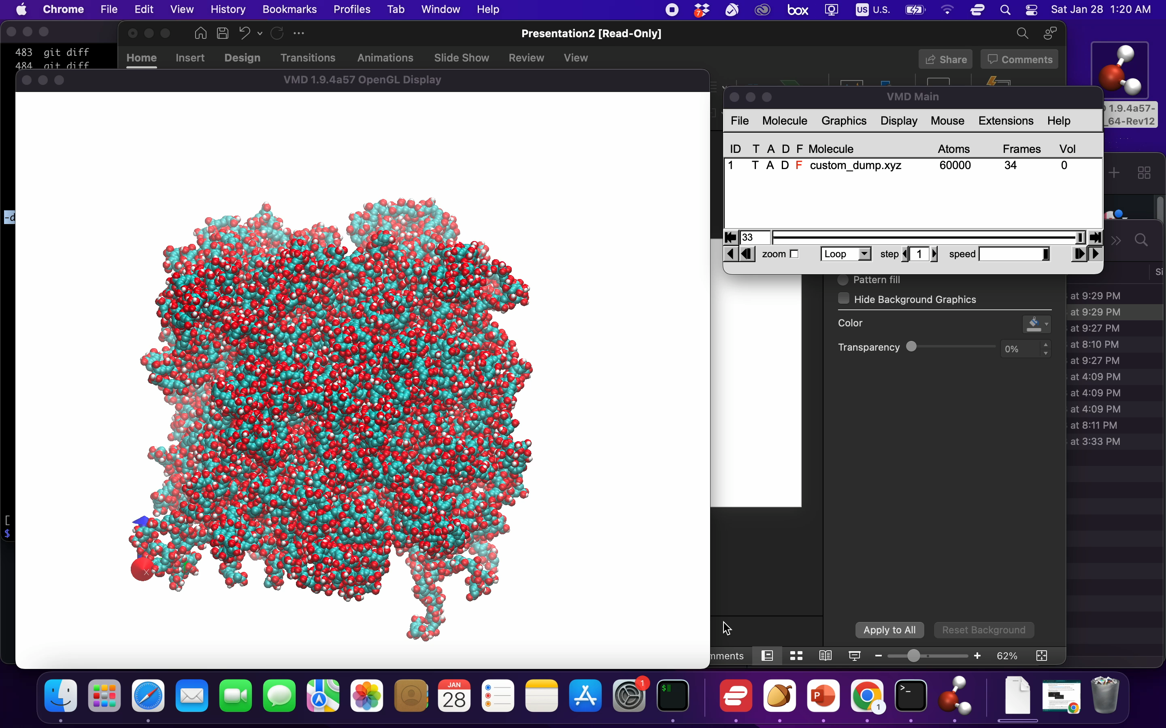
Efficient large scale amorphous cell builder with force field assignment supporting s polymers
run_nemd polymer_builder_driver.py '*CC(*)C(=O)O' '*CC(*)C(=O)O' -cru_num 100 -mol_num 100 -seed 1234 -density 0.5 -cell grow
velocity all create 10.0 482748
fix 1 all nvt temp 10.0 10.0 100
run 20000
unfix 1
fix 1 all npt temp 10.0 10.0 100 iso 1 1 1000
run 10000
30 mins on this mac:
60K atoms at density 0.5 g/cm^3
Cubic box of size 133.77 angstrom

Slide 2
Molecule blends via three different methods
polymer_builder_driver.py
Build amorphous cell from molecules and monomers.
positional arguments:
CRU SMILES of the constitutional repeat unit (monomer)
options:
-cru_num CRU_NUM [CRU_NUM ...]
Number of constitutional repeat unit per polymer
-mol_num MOL_NUM [MOL_NUM ...]
Number of molecules in the amorphous cell
-seed SEED Set random state using this seed.
-cell CELL Amorphous cell type: 'grid' grids the space and put molecules into sub-cells; 'pack'
randomly rotates and translates molecules; 'grow' grows molecules from the smallest rigid
fragments.
-density DENSITY The density used for pack and grow amorphous cell. (g/cm^3)

Slide 3
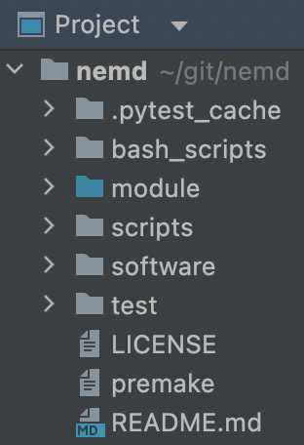
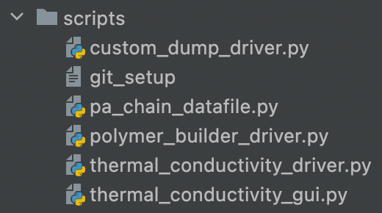
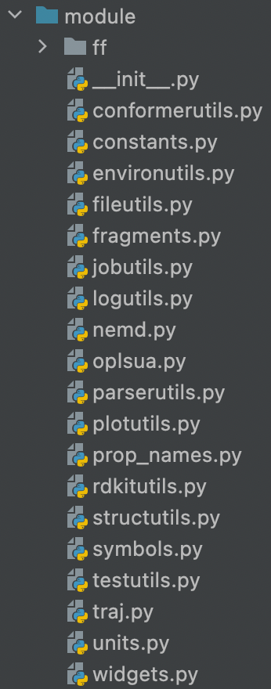
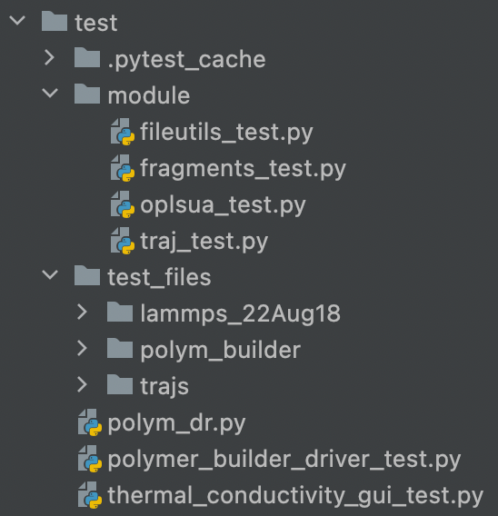
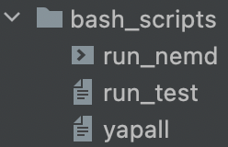

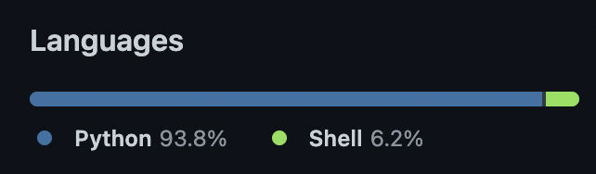
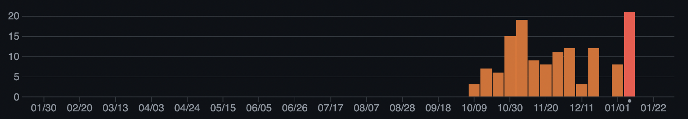
1000 lines for drivers
object oriented programming with doc strings
3000 lines for modules
modularization (handy api)
500 lines for unit tests
critical functionality protected

Slide 4
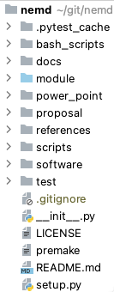
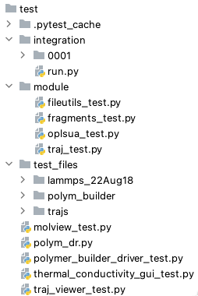
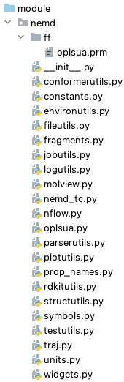
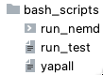
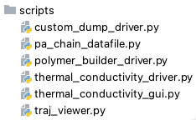
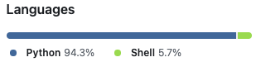
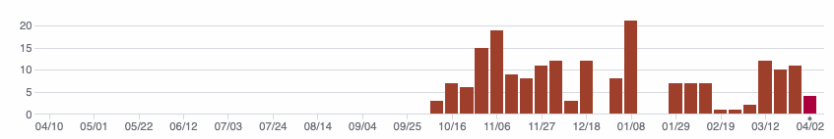
2000 行驱动
（文档标注的面向对象编程）
5000 行模块
（模组化易使用的程序接口)
1000 行单元测试
（核心功能实现保护）
1个整体测试
（确保驱动程式运算的稳定性）

Slide 5
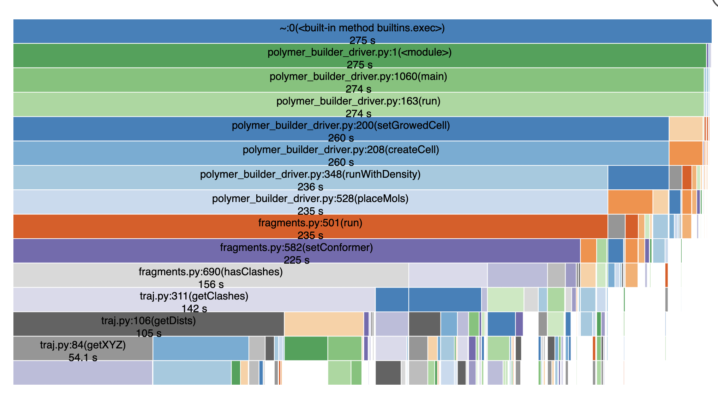

Slide 6
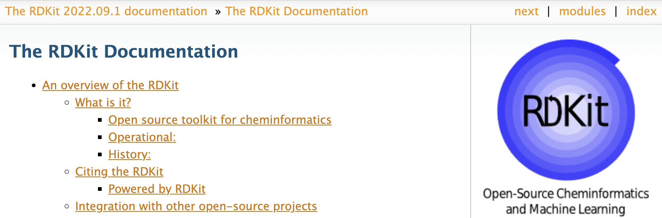
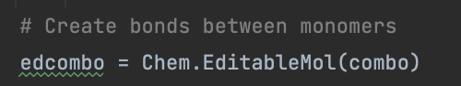

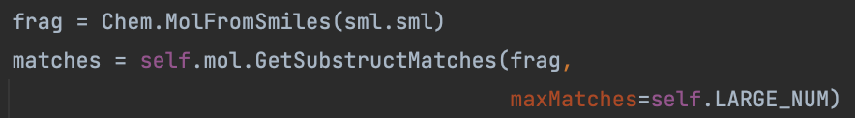
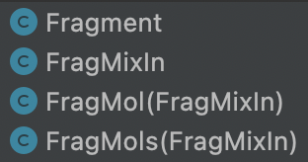
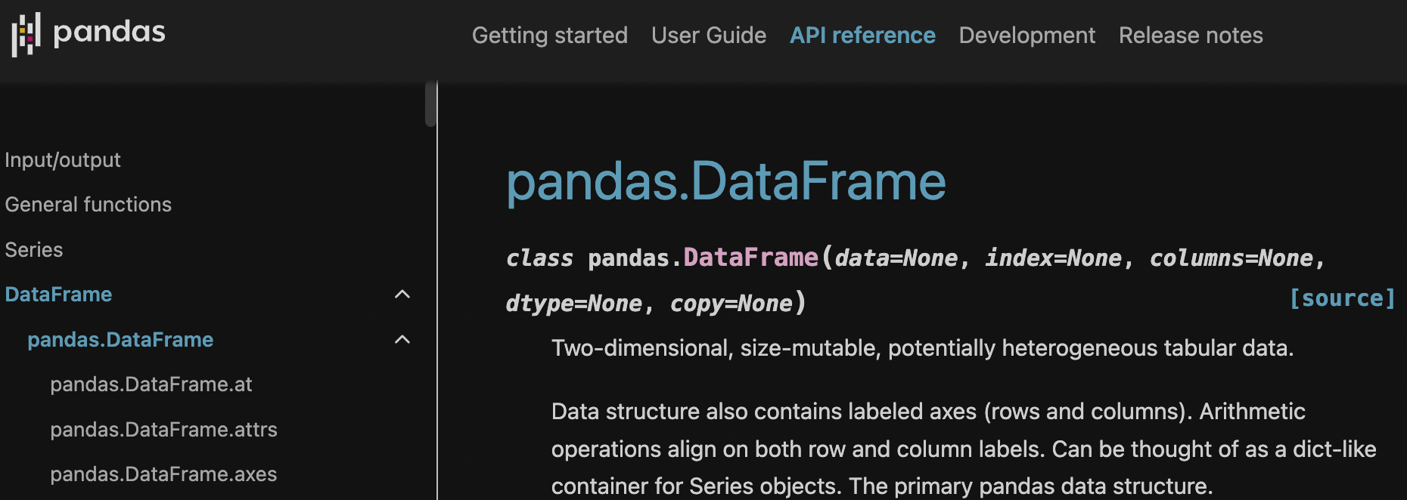
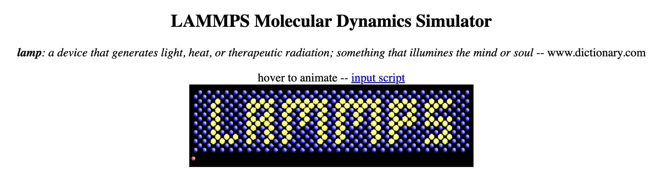
Components
SMILES to structure
Polymerization
Force field assignment
Coordinate generation
LAMMPS in script
LAMMPS datafile
Trajectory analysis
Refs:
RDKit: Open-source cheminformatics. https://www.rdkit.org
https://pandas.pydata.org/docs/index.html
Self-avoiding walk
(home-made)

Slide 7
run_nemd polymer_builder_driver.py '*CC(*)C(=O)O' -cru_num 10 -mol_num 10 -seed 1234 -density 0.5 -cell grow
lmp_serial < *.in or lmp_mpi *.in
16200 atoms
env OMP_NUM_THREADS=8 /usr/local/Cellar/lammps/20220623/bin/lmp_mpi -sf omp -in *.in
Loop time of 137.909 on 8 procs for 10000 steps with 16200 atoms
Performance: 6.265 ns/day, 3.831 hours/ns, 72.511 timesteps/s
648.1% CPU use with 1 MPI tasks x 8 OpenMP threads
mpirun -np 8 /usr/local/Cellar/lammps/20220623/bin/lmp_mpi -in *.in
Loop time of 144.099 on 8 procs for 10000 steps with 16200 atoms
Performance: 5.996 ns/day, 4.003 hours/ns, 69.397 timesteps/s
93.5% CPU use with 8 MPI tasks x 1 OpenMP threads

Slide 8
Dev Roadmaps:
More force field support. For example, https://www.rdkit.org/docs/source/rdkit.ForceField.rdForceField.html.
More force field support. For example, https://xtb-docs.readthedocs.io/en/latest/gfnff.html#introducing-gfn-ff
Manual for users
Slurm support for automation
4) Creating a pip installable package:
https://betterscientificsoftware.github.io/python-for-hpc/tutorials/python-pypi-packaging/
Application roadmaps:
UA vs AA amorphous thermal conductivity comparison
Network effects

